Slide 1
Hands-on Python for Networking! Session 3
29.Apr.2021

Slide 2
Agenda
Recap on Session 1 & 2
Interacting with Cisco devices.
Write some code! - Hands-on exercise
Introduction to NETCONF.
Interacting with Juniper network devices.
Write some code! - Hands-on exercise

Slide 3
Recap on session1 & 2
Python: Easy to learn, no previous programming skills required ☺
Data types : Int , String, List, Dict
If Conditions:
if a == ‘router1’: some code here elif b == ‘switch1’: something else here else: something else here
For/While loops.
Arg parsing
Interacting with files (CSV/text files)
Json Vs Python dict.
APIs with Python

Slide 4
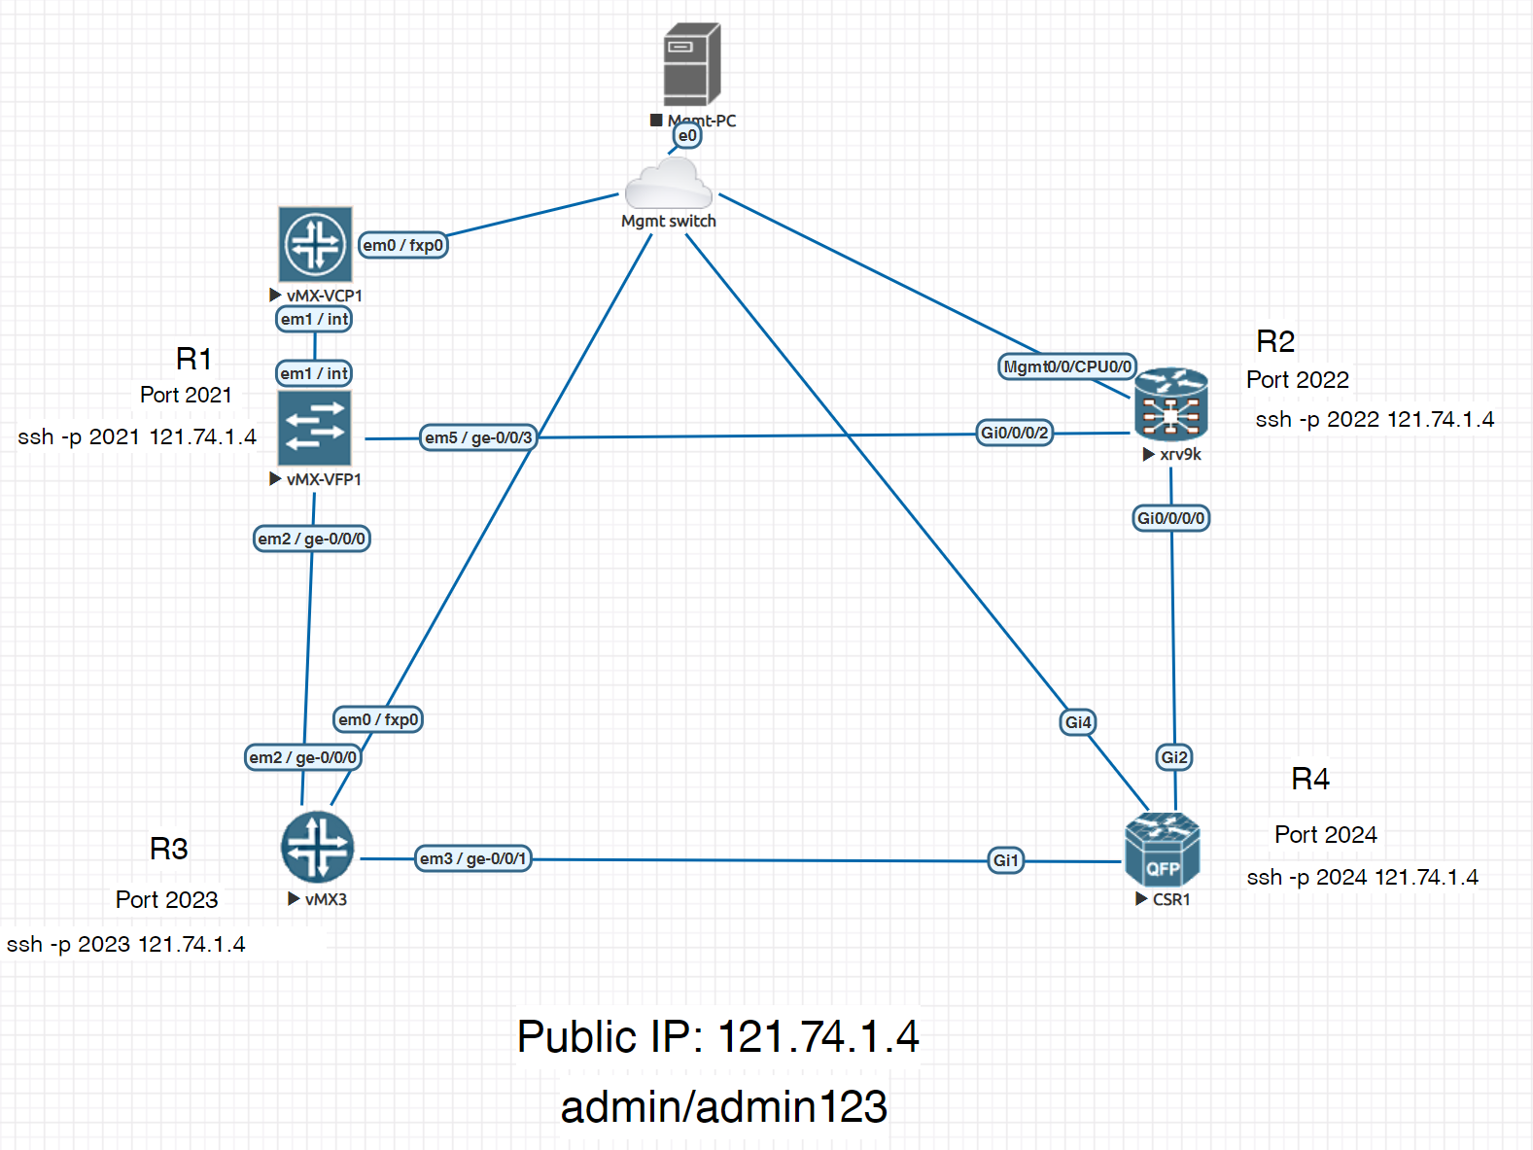
Lab Setup

Slide 5
Ways to interact with Cisco routers using Python
There are multiple python libraries that can interact with Cisco routers
Paramiko Vs Netmiko Vs NAPALM Vs Nornir
Paramiko :
Initial python implementation of SSH, used mostly when you want to use SSH to connect to devices.
Netmiko:
python library built on top of Paramiko, solves many issues connecting to network devices using paramiko
NAPALM:
Network Automation and Programmability Abstraction Layer with Multivendor support.
Used by Ansible
Which one I should be using ? Starting today, use Netmiko or NAPALM
Let’s demo Netmiko & NAPALM!

Slide 6
Netmiko
from netmiko import ConnectHandler
# Define device details
r2 = {'device_type': 'cisco_xr', 'host': '121.74.1.4', 'username': 'admin', 'password': 'admin123', 'port': '2022'}
# Connect to cisco routers
net_connect_r2 = ConnectHandler(**r2)
# Send command
output = net_connect_r2.send_command("show ipv4 int brief")
# configure the device
config_commands = ['no logging 1.1.1.1 vrf default', 'hostname ASR9K', 'commit', 'end']
config = net_connect_r2.send_config_set(config_commands)
# Disconnect
net_connect.disconnect()

Slide 7
Netmiko
Options to use with Netmiko:
net_connect.send_command() - Send command down the channel, return output back (pattern based)
net_connect.send_config_set() - Send configuration commands to remote device
net_connect.send_config_from_file() - Send configuration commands loaded from a file
net_connect.save_config() - Save the running-config to the startup-config
net_connect.enable() - Enter enable mode
net_connect.find_prompt() - Return the current router prompt
net_connect.commit() - Execute a commit action on Juniper and IOS-XR
net_connect.disconnect() - Close the connection
To turn the output to Python dict: use textfsm
result = net_connect_r4.send_command("show ip interface brief", use_textfsm=True)
Note: not all commands are supported on textfsm

Slide 8

Hands-on activity 4 – Netmiko
Write a program get_crc_errors.py to get the CRC errors of all interfaces of any of the routers and print it in the following format
Tip : command to get interface CRC errors “show interfaces”
Example
>> python get_crc_errors.py
GigabitEthernet1 CRC errors is xxxx
GigabitEthernet2 CRC errors is xxxx
GigabitEthernet3 CRC errors is xxxx
GigabitEthernet4 CRC errors is xxxx

Slide 9
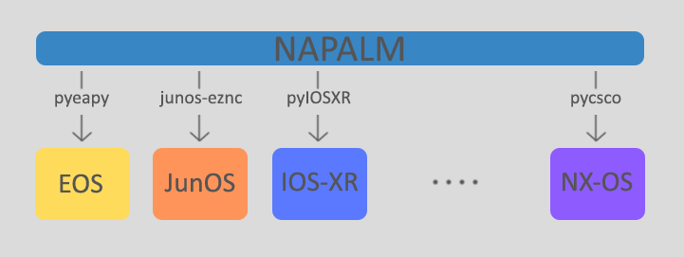
NAPALM
Network Automation and Programmability Abstraction Layer with Multivendor support.
Vendor neutral.
NAPALM hides the layer unifying the way we access a device

Slide 10
NAPALM
# use "python -m pip install napalm --user" to install the python package from "Anaconda prompt"
from napalm import get_network_driver
# get the correct network driver.
driver = get_network_driver('iosxr')
r2 = driver(hostname='121.74.1.4', username='admin', password='admin123', optional_args={'port':2022})
# Open connection to the device
r2.open()
# Get router facts
r2.get_facts()
# Get BGP information
r2.get_bgp_neighbors()
Full list of supported matrix
https://napalm.readthedocs.io/en/latest/base.html

Slide 11
Junos PyEZ – Python Library
Junos PyEZ is a Python library that enables you to manage and automate devices running the Junos operating system (Junos OS)
Retrieve facts or operational information from a device
Execute remote procedure calls (RPC) available through the Junos XML API
Install or upgrade the Junos OS software
Reboot or shut down the device
Perform common administrative tasks such as copying files and calculating checksums
retrieve configuration data
compare configurations
upload and commit configuration changes
roll back the configuration
manage the rescue configuration

Slide 12
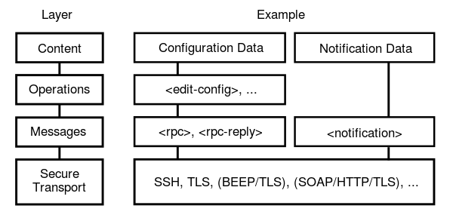
Netconf
NETCONF is a protocol that was developed to provide a standardized interface to Network Devices to retrieve and manipulate configuration data.
CLI is human friendly but not machine friendly
NETCONF operations are realized on top of a Remote Procedure Call (RPC) layer using an XML encoding
To enable netconf on Junipe devices
set system services netconf ssh

Slide 13
Junos PyEZ
from jnpr.junos import Device
# Create a device instance and connect to the device
from jnpr.junos import Device
r1 = Device(host='121.74.1.4',user='admin',password='admin123', port='2021')
# Open netconf session to r1
r1.open()
r1.facts
version_info = r1.rpc.get_software_information({'format': 'json'})
bgp_summary = r1.rpc.get_bgp_summary_information({'format': 'json'})

Slide 14
Junos PyEZ – load configs from local file
from jnpr.junos import Device
from jnpr.junos.utils.config import Config
dev = Device(host='dc1a.example.com').open()
conf_file = 'configs/junos-config-interfaces.conf'
with Config(dev, mode='exclusive') as cu:
cu.load(path=conf_file, merge=True)
cu.commit()
dev.close()

Slide 15
Additional Hands-on activity
Write a program backup_config.py to save the running configuration on a text file, device hostname to be entered as an argument.
>> python backup_config.py –-devices <hostname>
Write a program interface_discards.py to get tx/rx discards of all interfaces on Juniper devices , script to pause for 1 mins then compare the interface discards (doing that twice), device hostname to be entered as an argument.
>> python interface_discards.py –-devices <hostname>
Write a program cpu_memory.py to get cpu and memory levels for a cisco or Juniper device, hostname to be entered as an argument.
>> python cpu_memory.py –-devices <hostname>

Slide 16
Thank you

Slide 17
Backup Slides

Slide 18
Install python packages
To install python packages, open “Anaconda prompt” from start menu
"python -m pip install <package-name> --user“
For example to install the “requests” module
“"python -m pip install requests --user“
Note: disconnect the Corporate VPN/LAN connectivity while installing the packages

